Slide 1
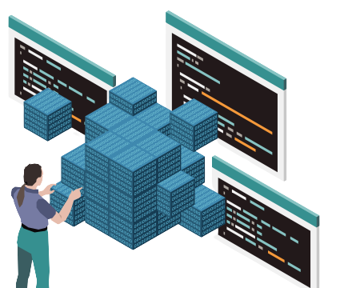

Object Oriented Programming
Notes:
"Welcome to our new session on Object-Oriented Programming (OOP)! In this session, we'll embark on a journey into the world of OOP, exploring its principles, concepts, and applications. Get ready to dive deep into the realm of classes, objects, inheritance, encapsulation, and polymorphism!"

Slide 2

WHAT……………….?
OBJECT-ORIENTED PROGRAMMING (OOP) is a programming paradigm that attempts to design and build computer programs the same way people think about and deal with the world. ​
An object-oriented program may be considered a collection of interacting objects. Each object is capable of sending and receiving messages, and processing data.​
Notes:
"Object-Oriented Programming (OOP) is a fundamental programming paradigm that mirrors how we perceive and interact with the real world."
"At its core, OOP treats a program as a collection of interacting objects, each capable of sending and receiving messages and processing data."
"Throughout this session, we'll explore the principles of OOP, from encapsulation and inheritance to polymorphism, and understand how they empower us to build robust and maintainable software systems."

Slide 3

WHY
Object-Oriented Programming (OOP) is used because it offers several benefits over other programming paradigms. Some of the major advantages of using OOP are:
Modularity
Reusability
Security
Flexibility
Notes:
"Let's delve into why Object-Oriented Programming (OOP) is such a popular choice among developers."
"First and foremost, OOP offers modularity, allowing us to break down our code into smaller, more manageable pieces called objects. This makes our code easier to understand, maintain, and debug."
"Another significant advantage is reusability. With OOP, we can create classes and objects that can be reused across different parts of our application or even in different projects, saving time and effort."
"Security is also a key benefit of OOP. By encapsulating data within objects and using access modifiers, we can control access to sensitive information, reducing the risk of unauthorized access or manipulation."
"OOP provides flexibility, allowing us to easily modify and extend our code as requirements change. This adaptability ensures that our applications can evolve over time without requiring major rewrites."
"And finally, OOP promotes scalability. By designing our applications with well-defined classes and objects, we can easily scale our codebase to handle larger datasets or accommodate new features."
"Overall, these benefits make Object-Oriented Programming a powerful paradigm for building robust, maintainable, and scalable software solutions."

Slide 4
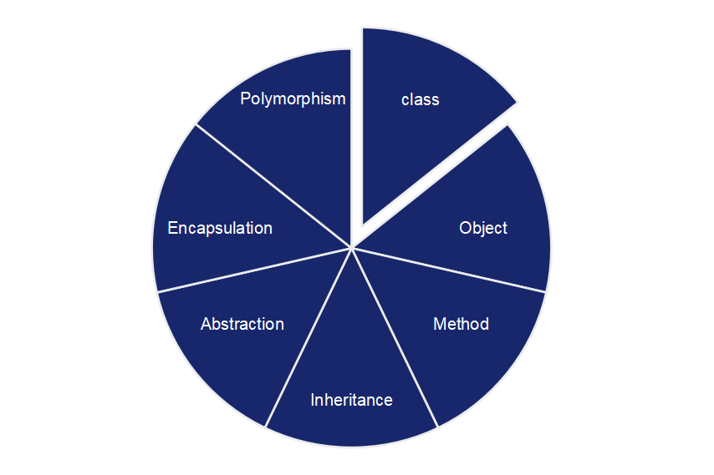
OOP's Concepts
Notes:
Object-Oriented Programming (OOP) revolves around seven key concepts: class, object, method, inheritance, abstraction, encapsulation, and polymorphism.

Slide 5

Class
A class is the blueprint from which the individual objects are created.
A class defines the characteristics of an object
It includes Attributes (its fields or properties) and the things it can do ( methods, operations or features).
Notes:
Alright, let's talk about classes - the building blocks of Object-Oriented Programming."
"Think of a class as a blueprint or template for creating objects. It defines what an object of that type will look like and what it can do."
"So, in simpler terms, a class defines the characteristics, or attributes, of an object, like its color, size, or shape. It also outlines what actions, or methods, the object can perform, like moving, jumping, or singing."

Slide 6

Example :
class
Job
Attributes
Methods
Title
Company
Salary
Responsibilities
Requirements
Apply
Interview
Accept Offer
Resign
Notes:
"Let's dive into an example to understand classes better. Imagine we have a class called 'Job'."
"Now, just like in real life, a job has certain attributes and methods. Attributes are like the characteristics of the job, while methods are the actions it can perform."
"So, for our 'Job' class, some attributes could include things like the job title, the company offering the job, the salary, responsibilities, and requirements."
"And when it comes to methods, well, our 'Job' class might have methods like 'Apply' to apply for the job, 'Interview' to schedule an interview, 'Accept Offer' to accept the job offer, and 'Resign' to resign from the job."
"By defining these attributes and methods within our 'Job' class, we can create individual job objects with specific titles, companies, and actions associated with them."

Slide 7
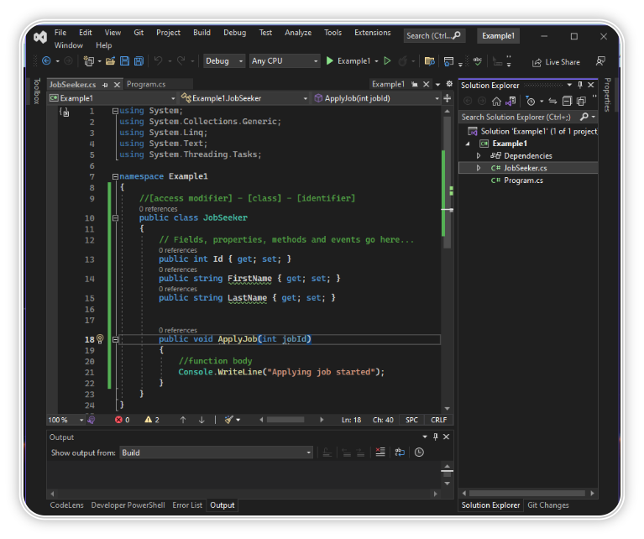
EXAMPLE :
Notes:
"For example, consider a class called 'JobSeeker'. It might have attributes like 'FirstName', 'LastName', and 'Location', and methods like 'ApplyJob'."
"These attributes represent the characteristics of a job seeker, like their name and location. And the methods represent actions they can take, like applying for a job."
"So, when we create an object from this class, it's like bringing that blueprint to life. We can create as many job seekers as we need, each with their own unique attributes and abilities."

Slide 8
Object
Objects are entities that have behavior , that hold information, and that can interact with one another.
In pure OOP terms an object is an instance of a class.
Notes:
"Let's dive into the world of objects in object-oriented programming."
"Objects are essentially the building blocks of our code - they're entities that have behavior, hold information, and can interact with each other."
"In pure OOP terms, an object is an instance of a class. Think of a class as a blueprint, and an object as a specific instance created from that blueprint."
"For example, let's take our 'Job' class. We can create objects of this class, each representing a specific job listing."
"These job objects would have attributes like title, company, salary, responsibilities, and requirements. And they'd also have methods like Apply, Interview, Accept Offer, and Resign."
"But it's not just limited to jobs. Objects can represent anything - a dancer, a cook, We can create objects for dancers, cooks, or anything else we can think of. Each object contains class attributes and behaviors defined by its class."

Slide 9
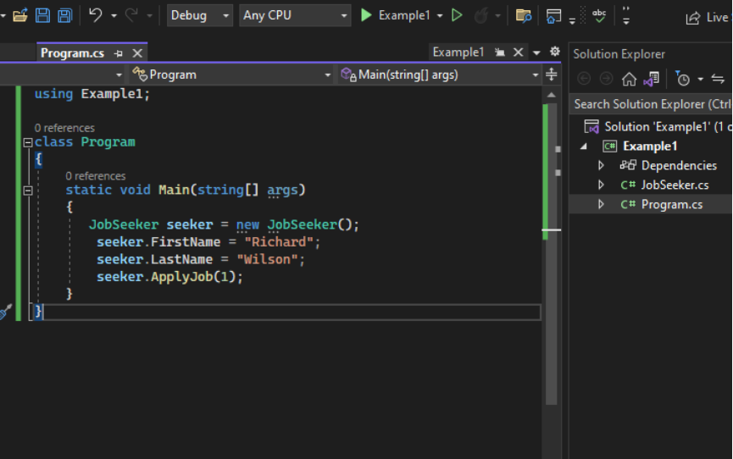
EXAMPLE :
In C#, objects are created using the "new" keyword followed by the name of the class to be instantiated.
Syntax :-
Class name object name =new constructor();
Notes:
"For example, let's take a class called 'JobSeeker.' It might have attributes like 'FirstName,' 'LastName,' 'Location,' and 'Phone,' which represent its characteristics."
"And it can also have methods like 'ApplyJob,' which represents what the object can do, like applying for a job."
"So, in essence, a class combines both the attributes (or properties) and the behaviors (or methods) of an object."
"Using this blueprint, we can create multiple objects of the same type, each with its own set of characteristics and abilities."

Slide 10

Inheritance
Inheritance can be defined as the process where one object acquires the properties of another.
A subclass(child) is a specialized version of a class, which inherits attributes and behaviors from the parent class
A child may also have additional unique behaviors and properties of its own that its parent does not have.
Notes:
"Let's dive into the concept of inheritance in object-oriented programming."
"Imagine inheritance as passing down traits from parents to children. In programming, it's similar— one object acquires the properties and behaviors of another."
"We have two key players: the parent class and the subclass, also known as the child class. The child class is a specialized version of the parent class, inheriting all its attributes and behaviors."
"But here's the cool part: the child class can also have its own unique traits that the parent class doesn't have. It's like adding toppings to a pizza—you still have the original base, but with extra flavor."
"So, inheritance allows us to create a hierarchy of classes, promoting code reuse, and enabling us to build more specialized and efficient programs."

Slide 11
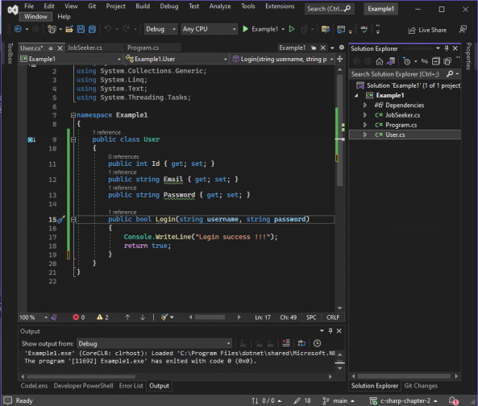
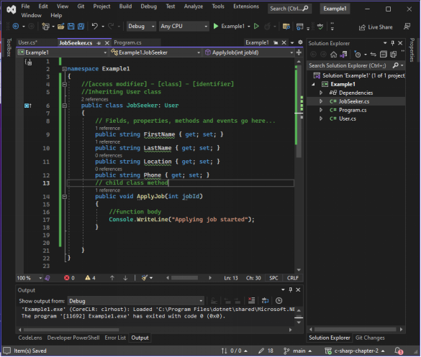
EXAMPLE :
Notes:
"Let's take a closer look at an example of inheritance in C#."
"We have two classes here: 'User' and 'JobSeeker.'"
"'User' is our parent class, which has properties like 'Id,' 'Email,' and 'Password.' It also has a method called 'Login.'"
"Now, 'JobSeeker' is our subclass, which inherits from 'User.' It adds its own properties like 'FirstName,' 'LastName,' 'Location,' and 'Phone,' as well as a method called 'ApplyJob.'"
"So, with inheritance, 'JobSeeker' automatically gets all the properties and methods from 'User,' and we can also add new functionalities specific to 'JobSeeker.'"

Slide 12
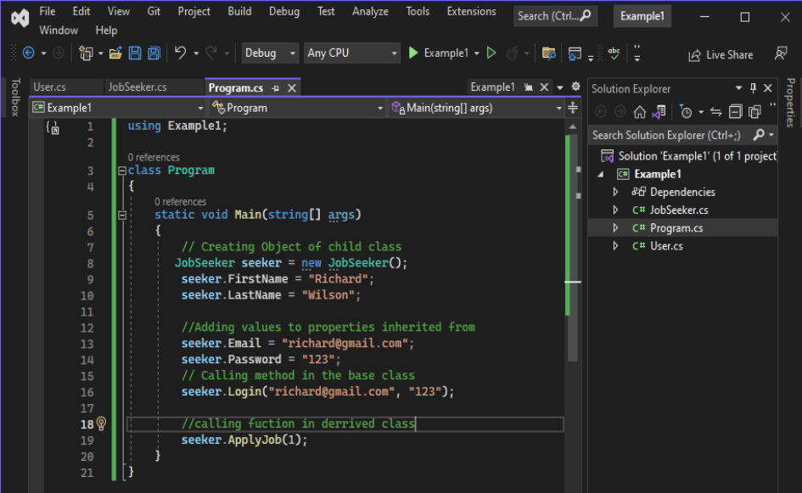
EXAMPLE :
Notes:
"In the 'Main' method of our program, we create an object of the 'JobSeeker' class and set values for its properties."
"We can see how the 'JobSeeker' class inherits the properties and methods from the 'User' class, allowing us to access and utilize them seamlessly."
"Through inheritance, we can build upon existing classes, promoting code reuse and making our programs more efficient and flexible."

Slide 13
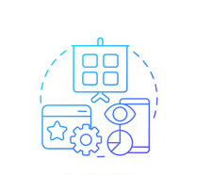
Abstraction
Abstraction is the practice of reducing details so that someone can focus on a few concepts at a time
Abstraction is "To represent the essential feature without representing the background details.“
Abstraction is the process of hiding the working style of an object, and showing the information of an object in an understandable manner.
Notes:
"Let's dive into the fundamental concept of abstraction in Object-Oriented Programming (OOP)."
"At its core, abstraction is all about simplifying complexity by reducing details and allowing focus on essential concepts."
"For instance, when explaining a car's functionality, we might focus on steering, accelerating, and braking without discussing the intricacies of the engine. That's abstraction in action—highlighting essential features while hiding background details."
"In OOP, abstraction involves hiding the inner workings of objects, making it easier to understand and interact with them."
"By embracing abstraction, we create code that's more manageable, maintainable, and adaptable to change."

Slide 14
Abstract class
An abstract class provides a common definition of a base class that can be shared by multiple derived classes.
It can have both abstract methods (which are implemented by child classes) and regular methods (which provide common functionality).
Notes:
"Let's explore the concept of abstract classes in Object-Oriented Programming (OOP)."
"An abstract class serves as a blueprint for other classes, providing a common structure and behavior that subclasses can inherit."
"Unlike regular classes, abstract classes cannot be instantiated directly. They often contain one or more abstract methods, which are declared but not implemented."
"To use an abstract class, we must create a subclass that extends it and provides implementations for its abstract methods."
"Abstract classes are useful for defining common functionality shared among related classes, while still allowing each subclass to customize its behavior."
"By defining abstract classes, we can promote code reuse, modularity, and maintainability in our applications."
"This code snippet defines an abstract class named 'User' in C#."
"The class contains properties for 'Id', 'Email', and 'Password', which are common attributes for users."
"Additionally, there's a non-abstract method 'Login' that provides a default implementation for user login functionality."
"However, the class also declares an abstract method 'Welcome', which means that any class inheriting from 'User' must provide its own implementation for the 'Welcome' method."
"Abstract classes are useful for defining common behaviors and characteristics shared among related classes, while still allowing each subclass to customize its own functionality."

Slide 15
Interface
An interface defines what a class or struct should do, but not how it does it.
It only contains method declarations, and the implementing class provides the logic for those methods.
Since C# does not support multiple inheritance for classes, interfaces allow a class to inherit multiple contracts.
Notes:
"Let's explore the concept of interfaces in object-oriented programming."
"An interface serves as a blueprint for classes, defining a set of methods that must be implemented by any class that implements the interface."
"Think of an interface as a contract - it specifies what methods a class must have, but it doesn't provide any implementation details. Instead, those details are left to the classes that implement the interface."
"So, when we define an interface, we're essentially saying, 'Any class that wants to be considered this type must provide these methods.'"
"Interfaces enable us to achieve a form of multiple inheritance in our codebase, allowing classes to implement multiple interfaces to inherit behaviors from different sources."
"By using interfaces, we can promote code reusability, modularity, and flexibility in our object-oriented designs."

Slide 16
Difference between Abstract Class and Interface
Abstract Class | Interface
Can have both abstract and non-abstract methods. | Contains only method declarations (until C# 8.0 added default implementations)
Can include fields, constructors, and properties. | Cannot have fields or constructors.
Supports single inheritance. | Supports multiple inheritance.
Allows access modifiers. | All methods are public by default.
Notes:
"Let's explore the concept of interfaces in object-oriented programming."
"An interface serves as a blueprint for classes, defining a set of methods that must be implemented by any class that implements the interface."
"Think of an interface as a contract - it specifies what methods a class must have, but it doesn't provide any implementation details. Instead, those details are left to the classes that implement the interface."
"So, when we define an interface, we're essentially saying, 'Any class that wants to be considered this type must provide these methods.'"
"Interfaces enable us to achieve a form of multiple inheritance in our codebase, allowing classes to implement multiple interfaces to inherit behaviors from different sources."
"By using interfaces, we can promote code reusability, modularity, and flexibility in our object-oriented designs."

Slide 17
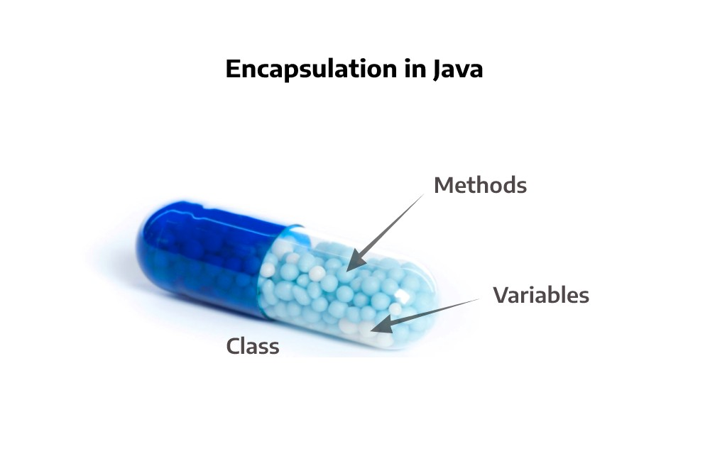
Encapsulation
Encapsulation Hiding the internal state and functionality of an object and only allowing access through a public set of functions..
Think of encapsulation as a black box; data is sent to a method, a lot of work goes on using the data, of which you don't know or care about. An output is returned to the caller. That is the process of encapsulation, or information hiding.
Encapsulation guarantees the integrity of the data contained in the object by preventing users from changing internal data into something invalid.
Notes:
"Let's delve into the concept of encapsulation in Object-Oriented Programming (OOP)."
"Encapsulation involves hiding the internal state and functionality of an object, allowing access only through a public set of functions."
"Think of encapsulation as a black box: you send data to a method, it performs some operations on that data internally, and returns an output to the caller. The caller doesn't need to know or care about the inner workings of the method—that's encapsulation at work."
"By encapsulating data and functionality within objects, we ensure the integrity of the data by preventing users from directly accessing or modifying it. This helps maintain consistency and validity of the object's state."
"Encapsulation plays a crucial role in promoting modularity, reusability, and maintainability of code, making it easier to develop and manage complex software systems."

Slide 18
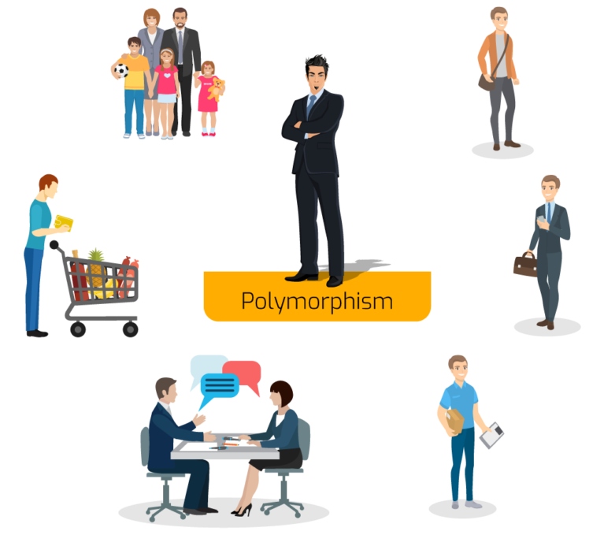
Polymorphism
The Word polymorphism comes from Greek and means having several different forms.
An object behaves differently at different place is called polymorphism.
Polymorphism is briefly described as "one interface, many implementations.
polymorphism can be achieved through method overloading and method overriding.
Notes:
"Let's explore the concept of polymorphism in Object-Oriented Programming (OOP)."
"The word 'polymorphism' originates from Greek, meaning 'having several different forms.'"
"At its core, polymorphism refers to the ability of objects to exhibit different behaviors or forms in different contexts."
"Think of it as one interface having many implementations. An object can respond to the same message or method call in different ways depending on the context."
"We can achieve polymorphism in OOP through two main techniques: method overloading and method overriding."

Slide 19
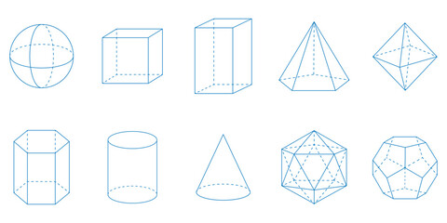
Method Overloading
Same method with different signature (number or type of arguments)
Notes:
"Let's delve into the concept of method overloading in Object-Oriented Programming (OOP)."
"Method overloading allows us to define multiple methods with the same name but different signatures within the same class."
"Signature refers to the number or type of arguments that a method accepts."
"For example, we can have multiple methods named 'CalculateArea' in a class, each accepting different parameters such as the dimensions of a shape or additional options."
"By providing multiple versions of the same method with different parameter lists, we can cater to different scenarios and improve code readability."
"Method overloading is a powerful tool that enhances the flexibility and usability of our codebase."

Slide 20
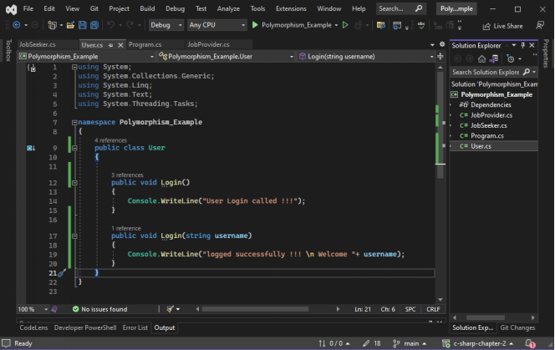
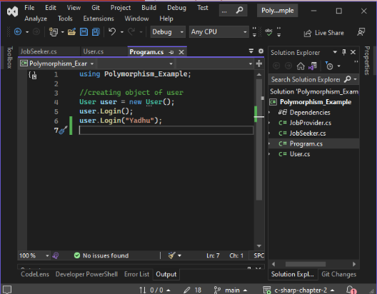
EXAMPLE :

Slide 21

METHOD OVERRIDING
In a class hierarchy, when a method in a subclass has the same name and type signature as a method in its super class, then the method in the subclass is said to override the method in the super class.
Notes:
"Let's explore the concept of method overriding in Object-Oriented Programming (OOP)."
"Method overriding occurs when a subclass provides a specific implementation for a method that is already defined in its superclass."
"In other words, if a method in a subclass has the same name and type signature as a method in its superclass, then the method in the subclass is said to override the method in the superclass."
"This allows the subclass to customize or extend the behavior of inherited methods to suit its own requirements."
"Method overriding is a key feature of inheritance, enabling polymorphic behavior where objects of different classes can respond differently to the same method call."
"By leveraging method overriding, we can achieve greater flexibility and modularity in our codebase."

Slide 22
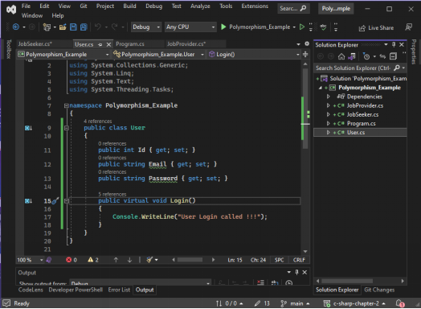
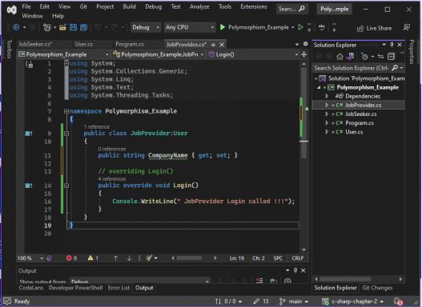
EXAMPLE :

Slide 23
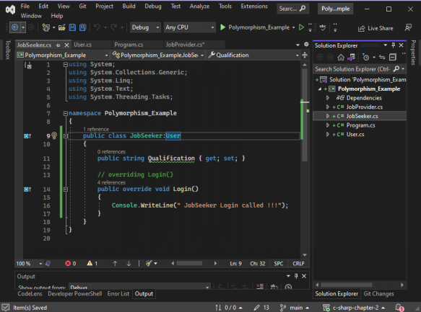
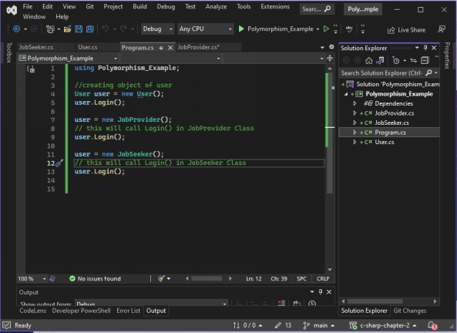
EXAMPLE :

Slide 24
Conclusion
Object-Oriented Programming (OOP) Concepts Overview:
Class and Object: Foundations for organizing code and representing real-world entities.
Inheritance: Enables code reuse and establishes hierarchies.
Polymorphism: Facilitates flexibility through multiple forms and behaviors.
Encapsulation: Bundles data and methods, enhancing information hiding.
Interface and Abstract Class: Contracts and blueprints for implementation and common base classes.
Abstraction: Simplifies complex systems by focusing on essential properties.
Why Use OOP:
Enhances code organization, modularity, and maintenance.
Promotes code reuse and a more intuitive representation of real-world entities.
Notes:
Conclusion :

Slide 25

Thank you

